Slide 1

INTRODUCTION TO DATA VISUALIZATION

Slide 2
WHAT IS DATA VISUALISATION?
Data visualization is the graphical representation of information and data.
By using visual elements like charts, graphs, maps, and infographics, data visualization tools help make large and complex datasets easier to understand, interpret, and communicate.
It transforms raw data into visual context so patterns, trends, and outliers become visible.

Slide 3




Improves Decision Making
Enhances Understanding
By clearly showing trends, anomalies, and relationships, data visualization supports better and faster decisions.
Humans process visuals faster than text. Data visualization turns abstract numbers into stories we can intuitively understand.
WHY IS DATA VISUALISATION IMPORTANT?
Simplifies Complex Data
Reveals Hidden Insights
Make it easier to grasp complex concepts or identify new patterns in data quickly
Patterns and correlations that aren’t obvious in raw data become clear through visual representation

Slide 4
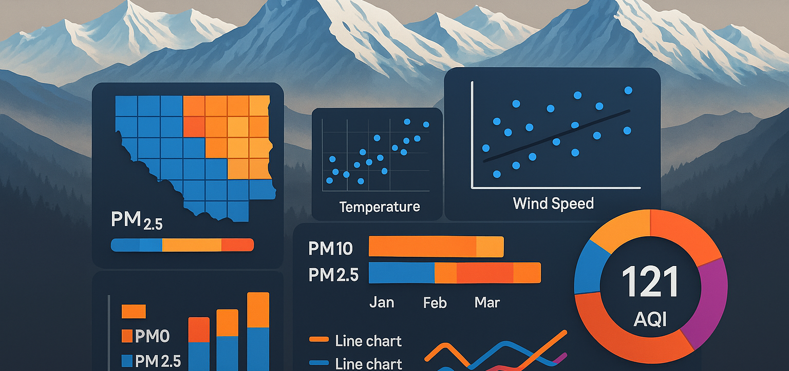
AIR IN THE VALLEY - A DATA DRIVEN LOOK
Case Study

Slide 5
🏔️ CASE STUDY: AIR IN THE VALLEY – A DATA DRIVEN LOOK
Air quality is no longer just a concern of the plains.
Is the air in the Himalayas still clean?
Once considered pristine, high-altitude regions are now facing pollution.
We’ll explore monthly air quality data (PM2.5, PM10) + meteorological factors

Slide 6
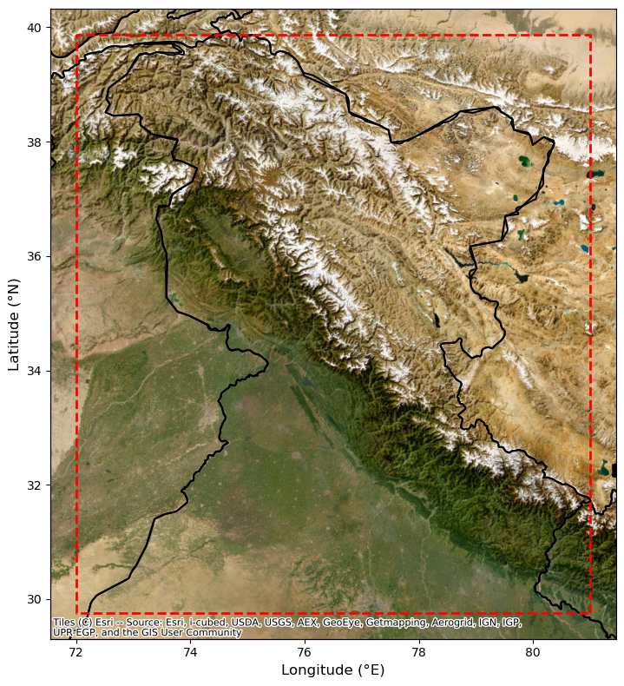
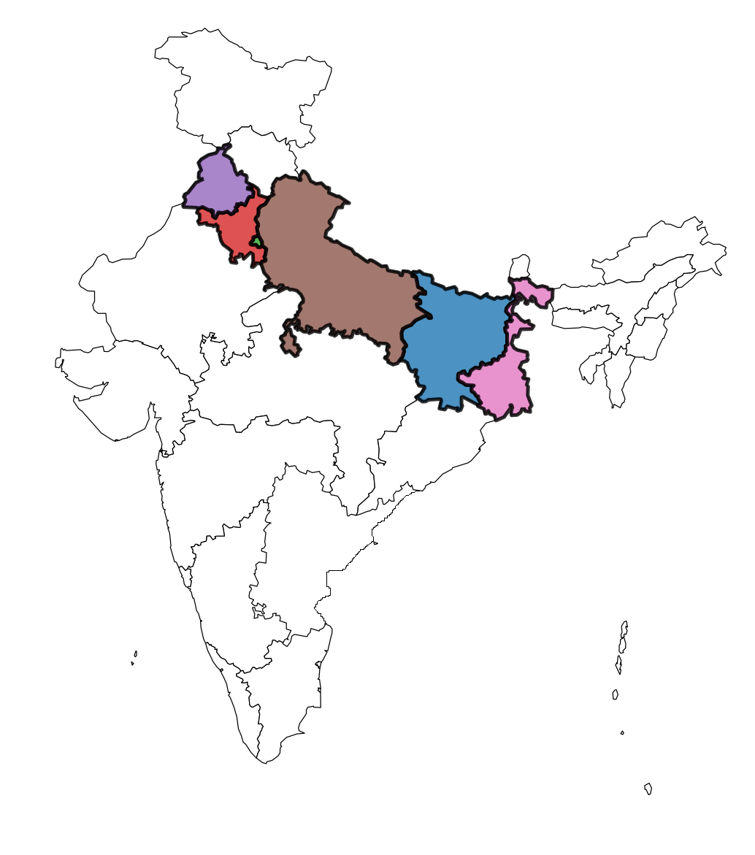
The adjacent Indo-Gangetic Plain (IGP) is a well-known global air pollution hotspot , but pollution is now spreading into the Himalayan environment through IGP, highlighting the urgent need for comprehensive air quality studies in this vulnerable region.
Frequent particulate matter (PM) pollution causes significant problems , as PM emissions are major factors affecting both climate and health.
IGP

Slide 7
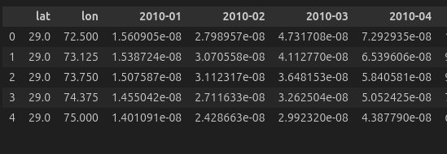
DATA DESCRIPTION
This study employs monthly gridded data on PM₂.₅, PM₁₀, and wind speed .
PM₂.₅ and PM₁₀ are airborne particulate pollutants originating from combustion, dust, and industrial activities with diameters ≤2.5 µm and ≤10 µm respectively, posing significant health risks due to their ability to penetrate the respiratory system.

Slide 8



OBJECTIVES
Univariate Analysis
Bivariate & Multivariate Analysis
Visualizations
Understand individual variables
See how they interact
Create visualizations using Python

Slide 9
Univariate Analysis
Understand the distribution of air quality and meteorological variables across the Northwest Himalayan region.

Slide 10
ss
Histograms
These are like bar graphs, except that they are useful in showing data frequencies or data values on classes (or ranges) of a numerical variable.
Objectives:
Analyze PM2.5, PM10 distribution patterns to understand pollution levels and meteorological conditions in elevated mountain environments, revealing how these parameters vary from typical urban lowland distributions.
ss
Box Plots
Statistical visualization tool used to summarize the distribution of a dataset. It provides a visual representation of the central tendency in a single plot.
Objectives
Identify central tendencies for each variable to detect unusual pollution episodes and typical
meteorological conditions in the Northwest Himalayas, helping distinguish between natural mountain air quality baselines.

Slide 11
WHY IS UNDERSTANDING THE DISTRIBUTION OF AIR QUALITY PARAMETERS CRUCIAL?

Slide 12
ss
Communicating distributions ( box plots, density plots) improves transparency.
Enables informed decision-making by citizens and local authorities, fostering greater community engagement and accountability in efforts to improve air quality
ss
2. Public Communication and Risk
Awareness
1. Assessment Against Health-Based Guidelines
The WHO Air Quality Guidelines provide threshold limits for pollutants PM₂.₅(5 μg/m³), PM₁₀(15 μg/m³) .
Understanding the statistical distribution—such as mean, median helps us:
Identifying the frequency and severity of exceedances (e.g., how often PM₂.₅ exceeds 5 µg/m³ annual mean guidelines).

Slide 13
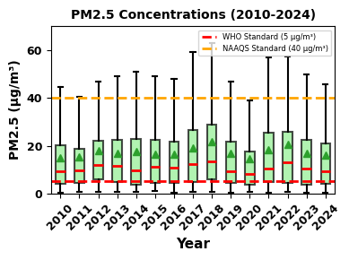
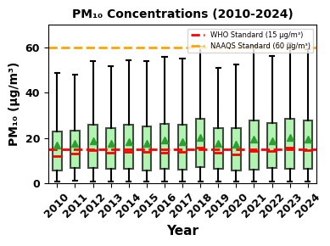
Example of Box plot for PM2.5
Example of Box plot for PM10
Key Insights
ss
ss
ss
1.PM₂.₅ levels significantly exceeds WHO guidelines (5 μg/m³), posing serious health risks.
2.PM₁₀ concentrations surpass WHO limits (15 μg/m³) but remain within NAAQ standards.
3. Pollutant levels declined during the COVID-19 period, particularly in 2019 and 2020, as seen in the figures.

Slide 14
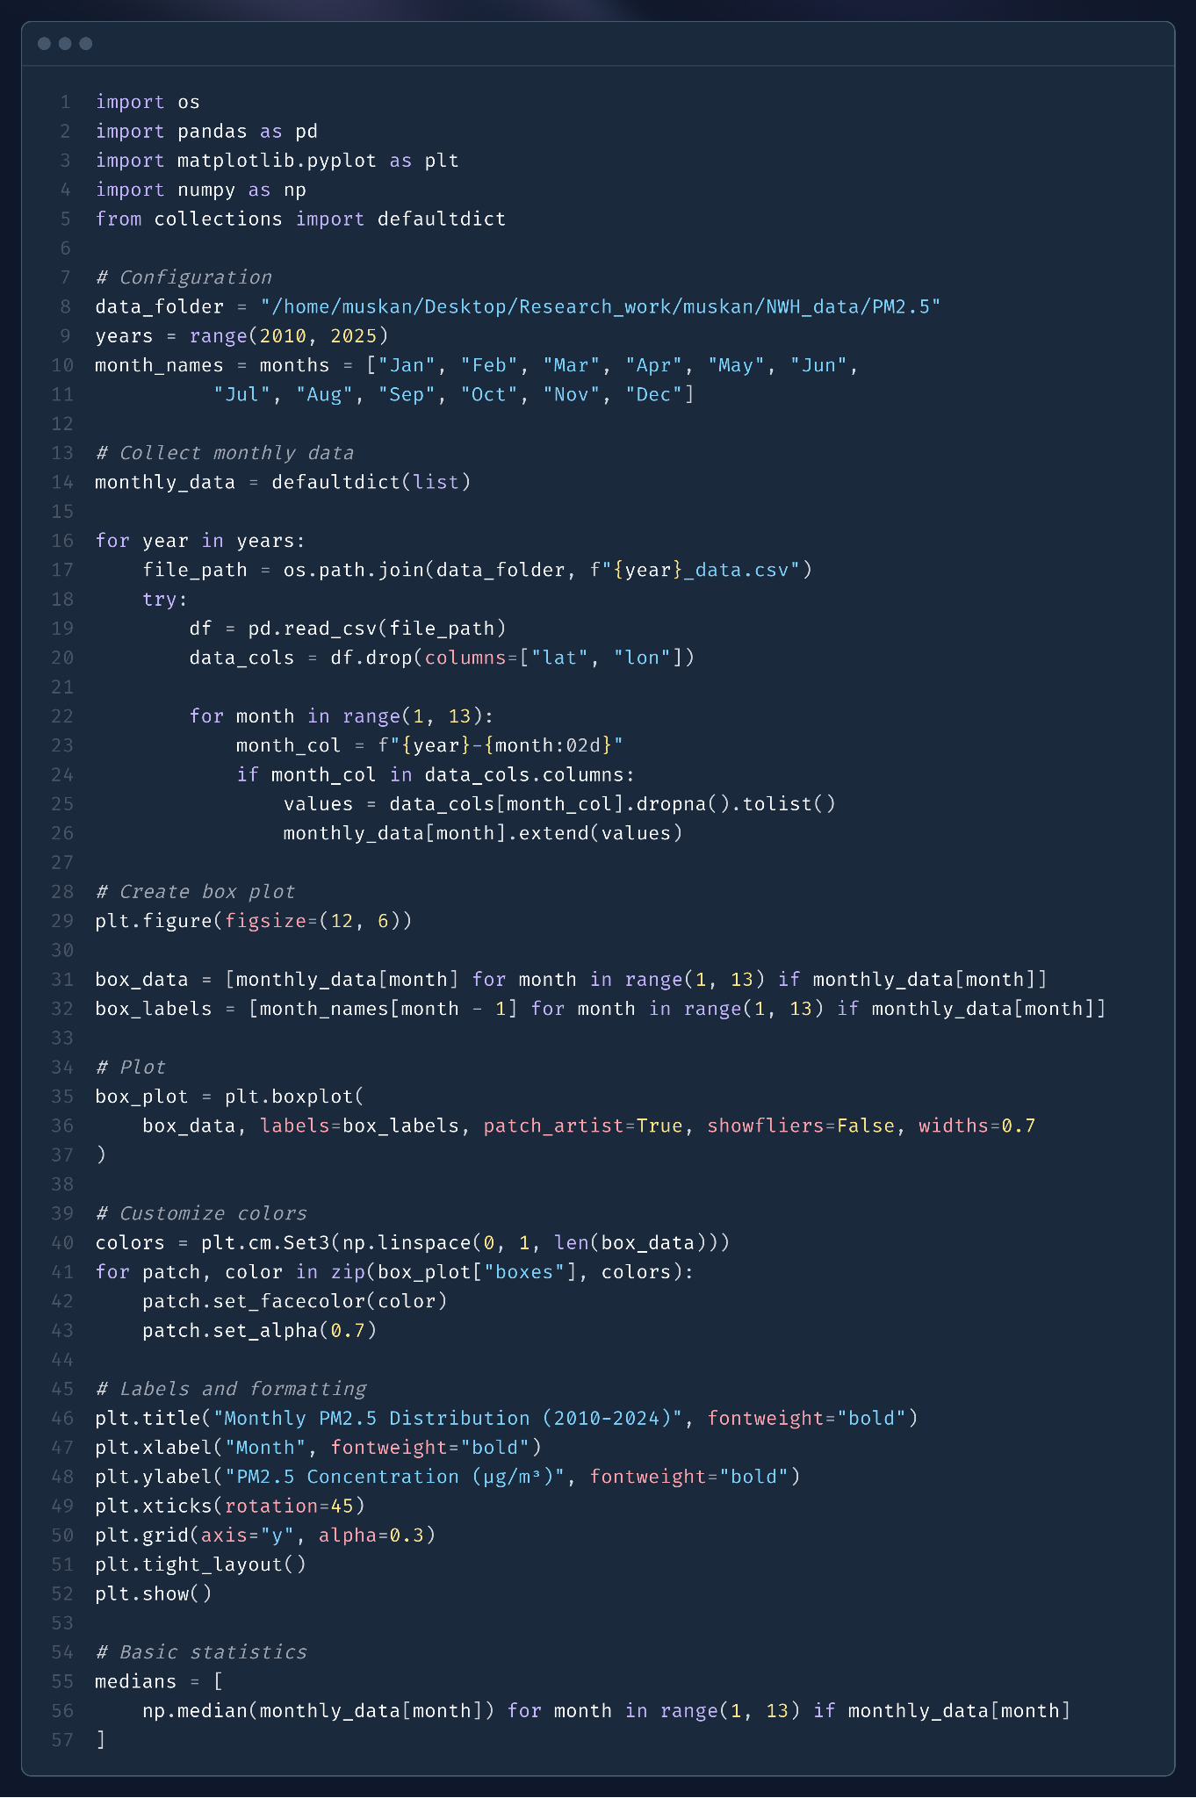
🧪 Code Snippet: Monthly PM2.5 Boxplot (2010–2024)

Slide 15
BIVARIATE ANALYSIS
ss
ss
Why Bivariate Analysis is Essential?
What we still don’t know
✓ Individual patterns for each variable
✓ Seasonal trends for PM2.5, PM10
✓ Distribution characteristics and outliers
❓ Are these patterns connected?
❓ What's causing the seasonal differences?
❓ How do weather conditions affect pollution levels?

Slide 16
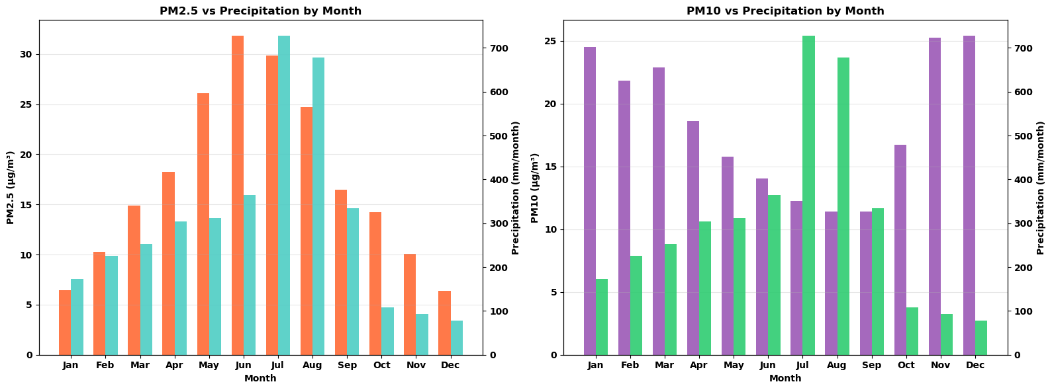
BAR PLOTS FOR PM2.5,PM10 VS PRECIPITATION
ss
ss

Slide 17
ss
ss
The relationship between PM₂.₅ concentrations and precipitation reveals:
The relationship between PM₁₀ concentrations and precipitation reveals:
PM₁₀ concentrations show a more expected inverse relationship with precipitation. As rainfall increases during the monsoon season, PM₁₀ levels decrease significantly.
This is due to the higher deposition velocity of coarse particles like PM₁₀ (3.19 cm·s⁻¹), making them more efficiently removed from the atmosphere via wet deposition
Despite increased rainfall during the monsoon (June–September), PM₂.₅ levels remains elevated.
This anomaly is explained by the “Greenfield gap” phenomenon, which highlights that fine particles (0.1–2.5 μm) are less efficiently removed by wet deposition .
PM₂.₅ has a much lower deposition velocity (0.32 cm·s⁻¹), resulting in its persistence even during high rainfall periods.

Slide 18
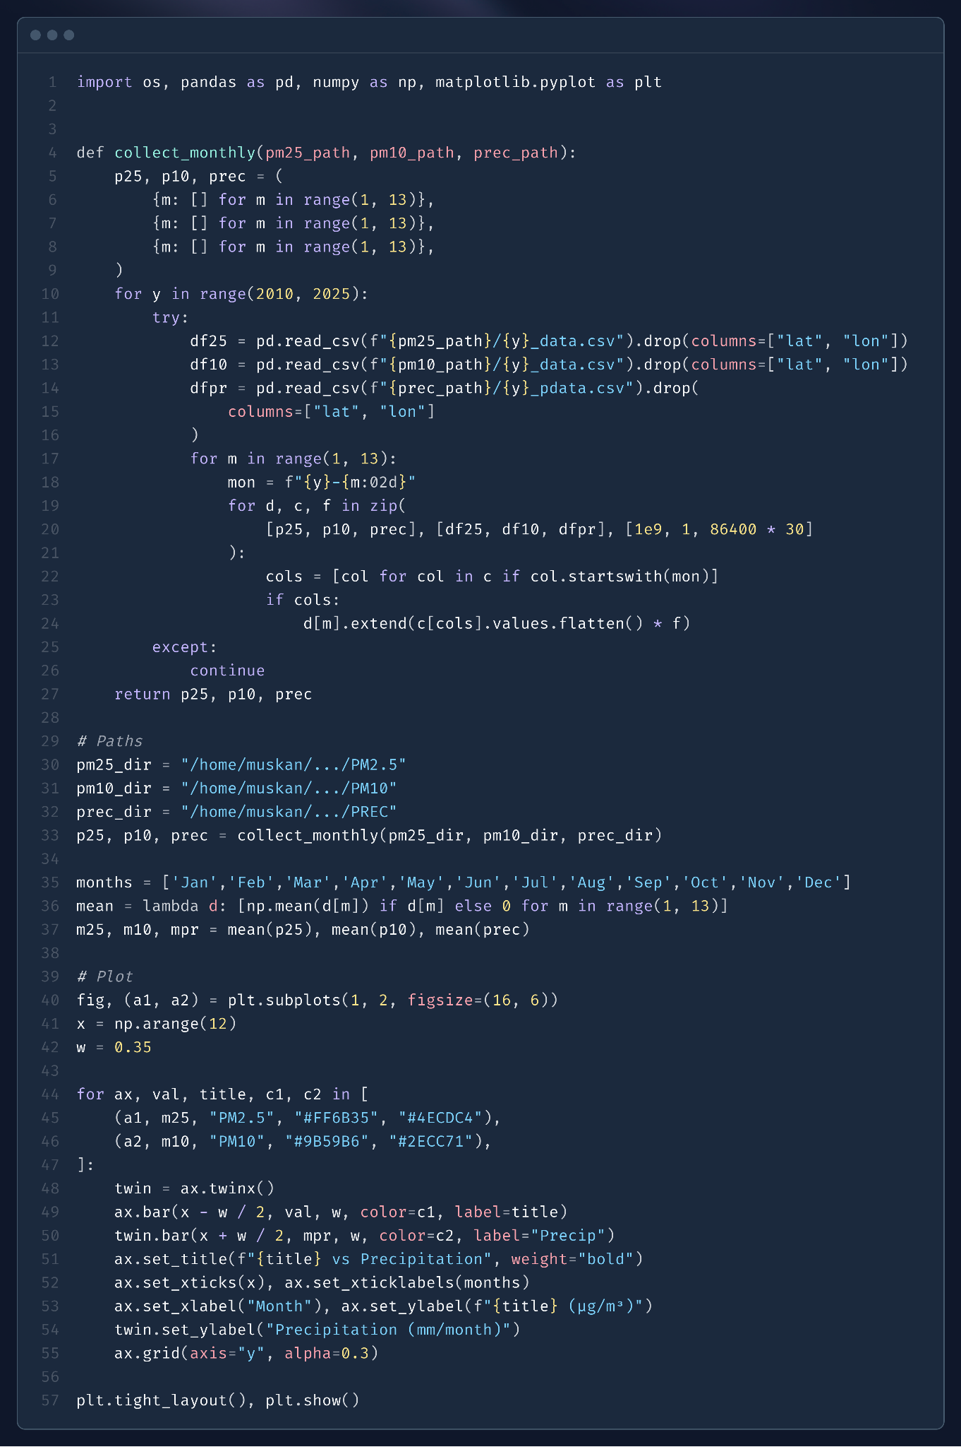
🧪 Code Snippet: Dual Bar Analysis - Particulate Concentration vs. Monthly Rainfall

Slide 19
SCATTER PLOTS
ss
ss
Purpose of Scatter Plots:
Why Perfect For Our Study
Scatter plots allow us to see these interactions directly - showing whether wind actually cleans the air.
How effective rainfall is at reducing particles, and whether temperature changes affect pollution concentrations.
Each point represents one observation where both variables were measured simultaneously (e.g., rainfall and PM2.5 on the same day). Patterns emerge that show whether variables move together,move opposite to each other, or have no relationship at all.

Slide 20
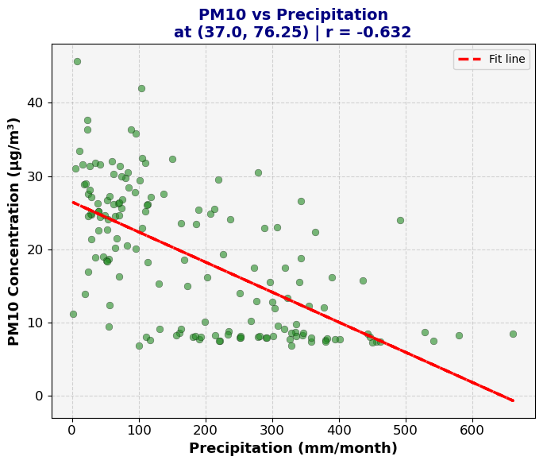
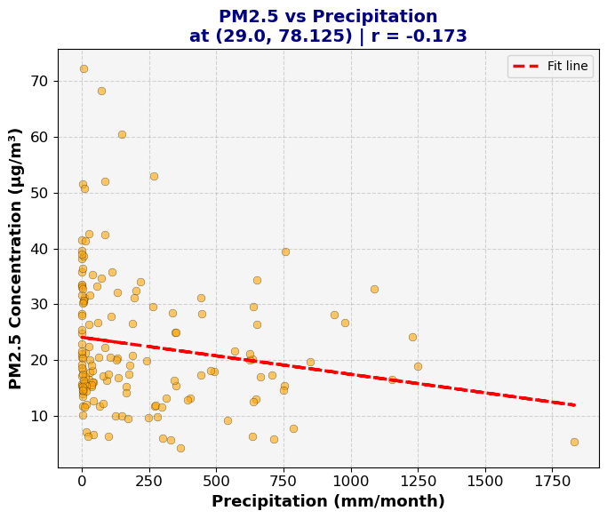
ss
ss

Slide 21
ss
ss
PM₂.₅ vs Precipitation at (29.0°N, 78.125°E)
PM₁₀ vs Precipitation at (37.0°N, 76.25°E)
A negative correlation coefficient (r = -0.173) suggests a weak inverse relationship: as precipitation increases, PM₂.₅ levels tend to decrease slightly.
As we discussed in bar plots ,that PM2.5 is less efficiently removed by wet deposition .
A negative correlation (r = -0.632) is observed, indicating a substantial decrease in PM₁₀ levels with increasing rainfall.
This relationship suggests effective wet deposition (washout effect), where rainfall removes coarse particles (PM₁₀) from the atmosphere more efficiently than fine particles.

Slide 22
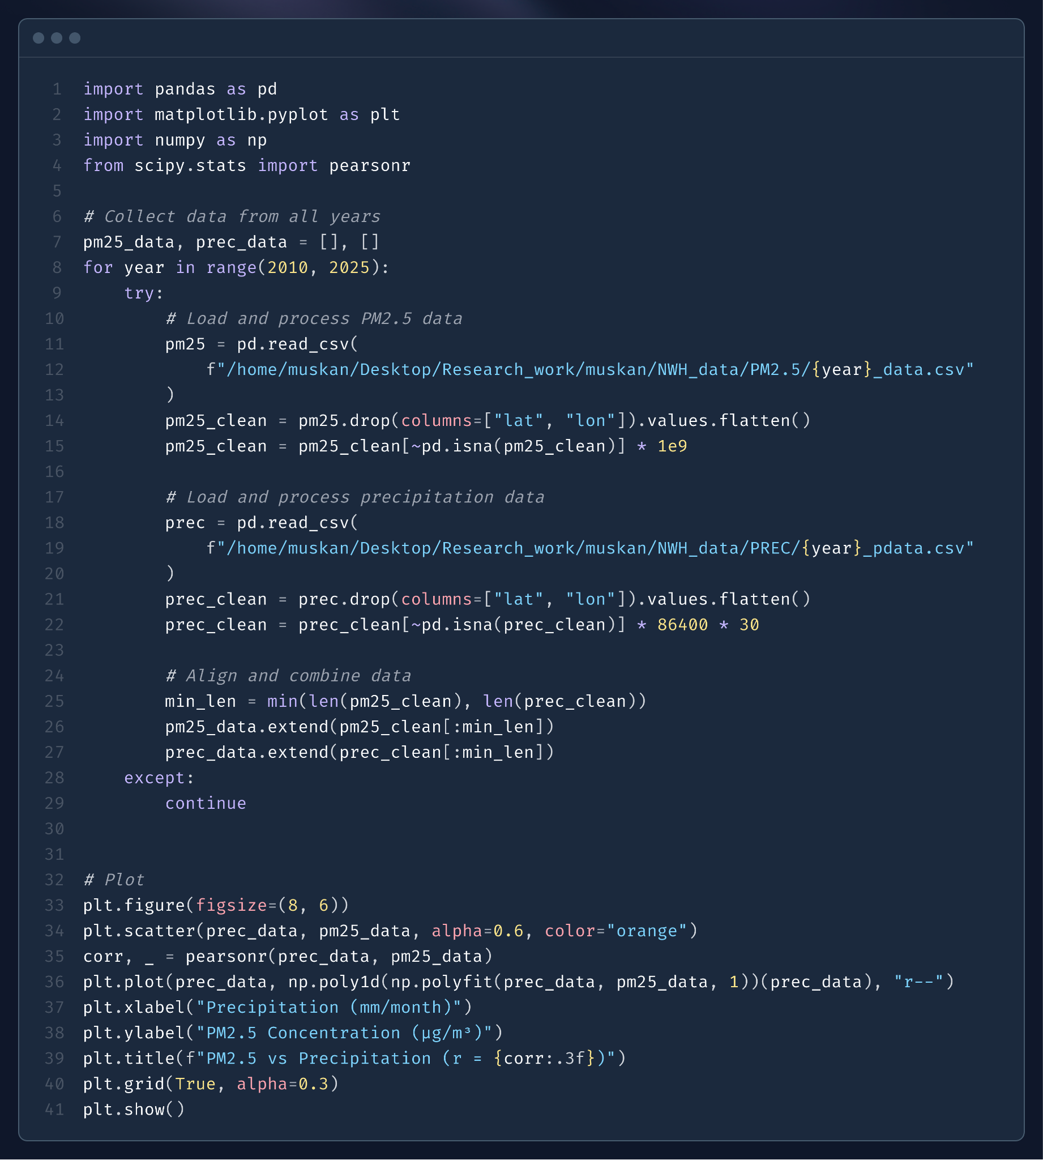
🧪 Code Snippet: Scatter Plot Analysis of PM2.5 Concentrations vs Precipitation

Slide 23
MULTIVARIATE ANALYSIS
ss
ss
Multivariate Analysis
Why Move Beyond Bivariate Analysis
Examines relationships between three or more variables simultaneously, rather than looking at pairs individually (bivariate analysis).
Missing the bigger picture: Air quality is influenced by multiple factors working together.
Confounding variables: Other factors may mask or enhance apparent relationships

Slide 24
HEATMAPS
ss
ss
Visual Data Made Simple
Correlation Understanding Made Easy
A heatmap is like a weather map on TV - it uses colors to show data instead of confusing numbers. This makes it much easier to spot patterns quickly rather than reading through hundreds of numbers in a table.
The correlation heatmap answers the question: "When one thing goes up, does another thing also go up?"

Slide 25
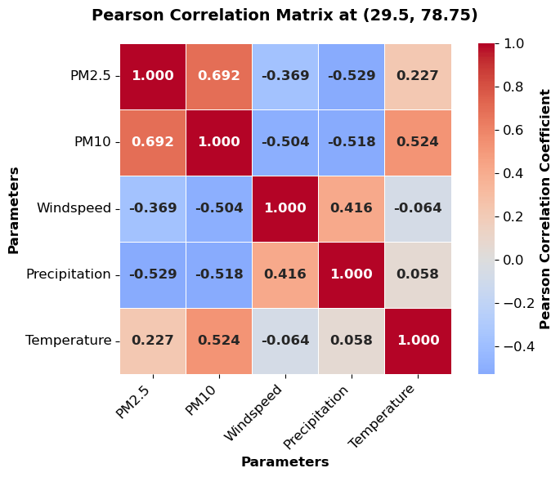
ss
How to Read it:
Dark Red (like 1.000): Perfect relationship - they always move together
Orange (like 0.575): Good relationship - when one goes up, the other usually goes up too.
Light Blue (like -0.261): Weak opposite relationship - slight tendency to move in opposite directions
Dark Blue (like -0.704): Strong opposite relationship - when one goes up, the other goes down

Slide 26
KEY INSIGHTS
ss
ss
Air pollution types cluster together - if you have one type of particulate pollution, you likely have others.
Weather factors interact predictably - wind cools things down, rain coincides with cooler weather.
Temperature is a key player - it has meaningful relationships with both wind and precipitation

Slide 27

🧪 Code Snippet: Correlation analysis using Heatmaps

Slide 28
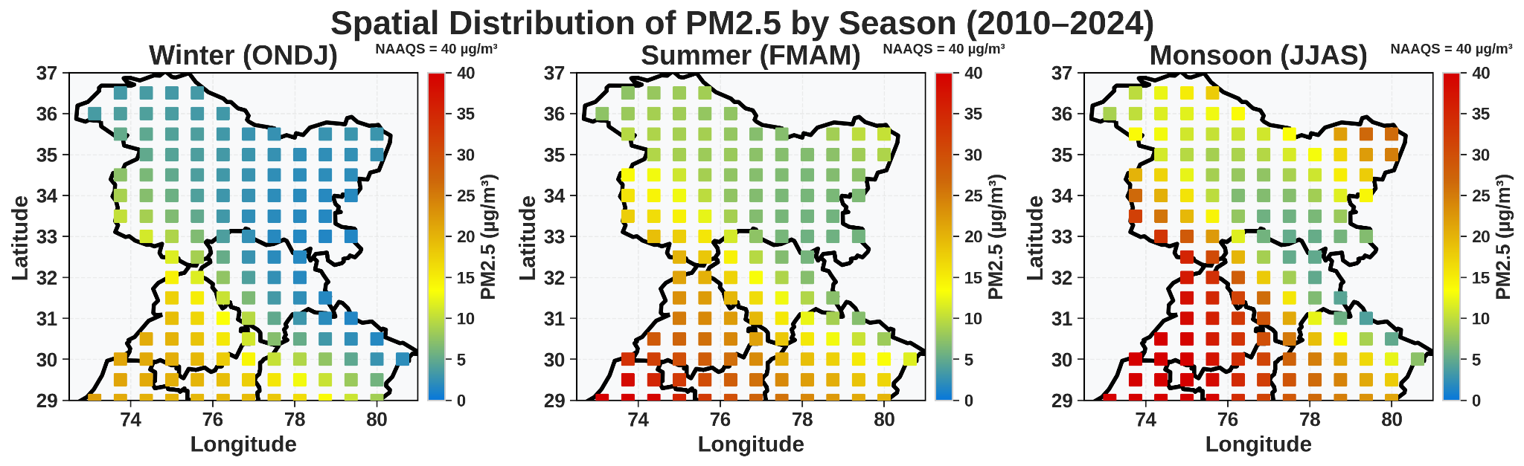
SPATIAL DISTRIBUTION OF SEASONAL AVERAGE AIR POLLUTANTS CONCENTRATIONS
An elevation gradient in PM2.5 concentrations is observed during monsoon months, with higher concentrations recorded at elevated sites relative to mid-elevation locations.
This could be explained by enhanced biogenic volatile organic compound (BVOC) emissions from alpine vegetation at higher elevations during monsoon, which undergo aqueous-phase oxidation in cloud droplets to form secondary organic aerosols (SOAs) .
These secondary organic aerosols, containing both sulfate and organic components, represent up to 40% of total PM₂.₅ mass at 3,000 m altitude during monsoon periods.

Slide 29

🧪 Code Snippet: Spatial Plot Analysis of PM2.5 Concentrations

Slide 30
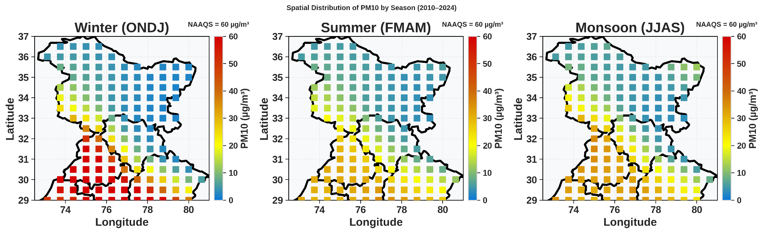
PM₁₀ distribution during winter months, with concentrations decreasing systematically from lower elevations (highest) through mid-elevations (moderate) to higher elevations (lowest).
This can be explained as the influence of stable atmospheric conditions and low mixing heights that trap coarse particles near the surface.
Also in winters , there is minimum rainfall occur, so there is not washout of PM10 takes place .

Slide 31

🧪 Code Snippet: Spatial Plot Analysis of PM10 Concentrations

Slide 32
WIND ROSE DIAGRAM
A wind rose is a circular diagram that graphically represents the frequency and direction of wind at a specific location. It's essentially a visual summary of how often wind blows from different directions.
Key Components:
Circular Shape: The circle represents all possible wind directions.
Spoke Length: The length of each spoke indicates the percentage of time that wind blew from that particular direction. A longer spoke means the wind blew from that direction more frequently.
Colors or Shades:
Colors or shades along the spokes are used to represent wind speed categories, further enhancing the information provided.

Slide 33
HOW TO INTERPRET A WIND ROSE:
1. Identify Dominant Wind Directions:
Look for the longest spokes. These indicate the directions from which wind blows most frequently.
2. Consider Wind Speed:
If wind speeds are represented, pay attention to the color or shading of the spokes to understand the typical wind speed for each direction
3. Determine Calm Winds:
A small spoke near the center often indicates calm winds (no wind or very light winds)

Slide 34
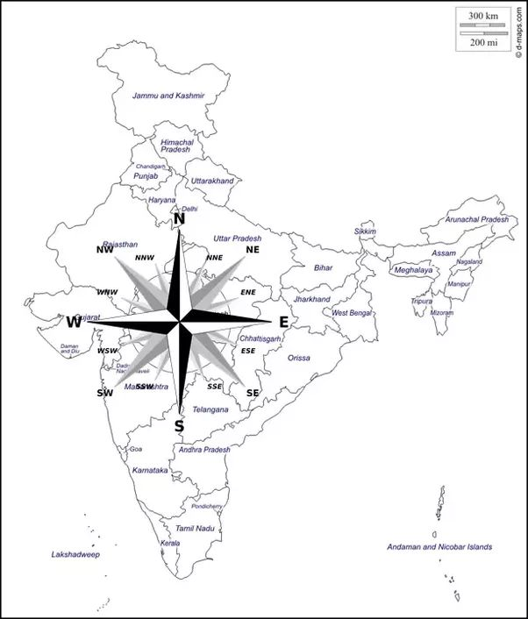
🧭 GEOGRAPHICAL ORIENTATION OF THE NORTHWEST HIMALAYAS:
The image shows a map of India with an overlaid 32-point compass rose, which includes all major and intermediate directions (e.g., N, NE, ESE, SW). This directional overlay is essential for understanding the geographical orientation of the Indo-Gangetic Plain (IGP) and analyzing environmental or atmospheric data with respect to wind direction.
The compass rose helps accurately determine the direction of wind flow and pollutant transport across this region.
For example, if data shows winds blowing from the West-Southwest (WSW) direction, this indicates that air masses may be originating from the Thar Desert region in Rajasthan.

Slide 35
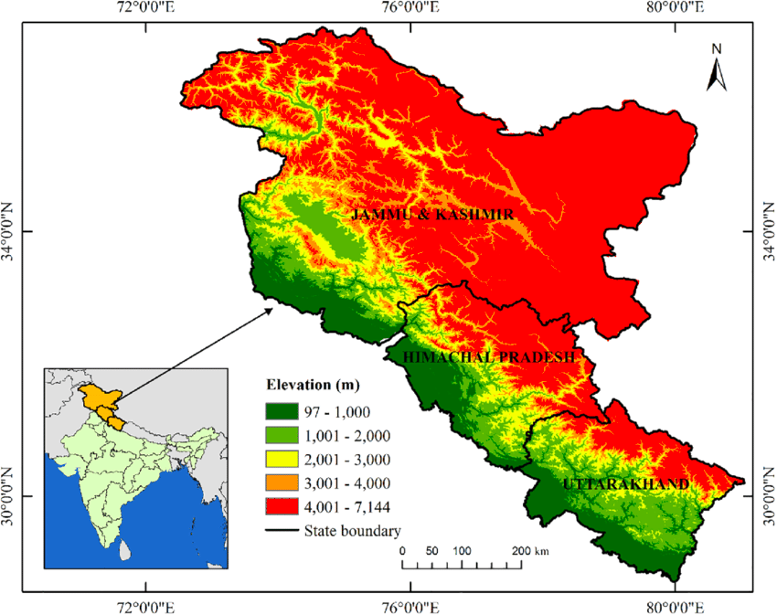
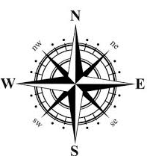
Jammu & Kashmir lies to the northwest, Himachal Pradesh to the west-southwest, and Uttarakhand to the southwest of the Northwest Himalayan region.
IGP BELT :
Punjab is to the west , Haryana to the west-southwest, Delhi to the southwest, western Uttar Pradesh to the south, Bihar to the southeast, and West Bengal to the far southeast of the Northwest Himalayas.
So, primarily, the Indo-Gangetic Plain (IGP) lies to the south and southeast of the Northwest Himalayan (NWH) region.

Slide 36
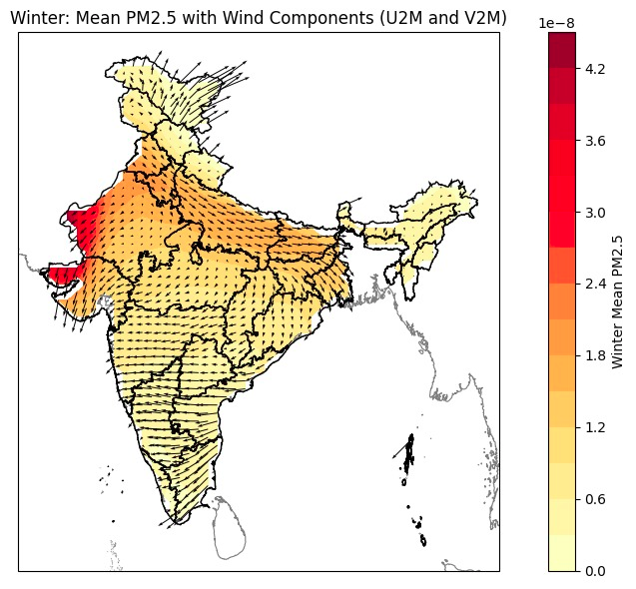
The spatial distribution of winter mean PM₂.₅ concentrations across India, overlaid with surface wind vectors (U2M and V2M components), reveals significant regional variation influenced by both emission sources and atmospheric transport.
Elevated PM₂.₅ levels are observed over northwestern India, particularly in parts of Rajasthan, Punjab, Haryana, indicating strong local emissions likely linked to industrial activity, vehicular traffic, and residual biomass burning.
The wind vectors show a dominant northwesterly to southeasterly flow during winter. These prevailing winds facilitate the movement of PM₂.₅ but it is not moving towards the IGP or foothills of NWH .

Slide 37
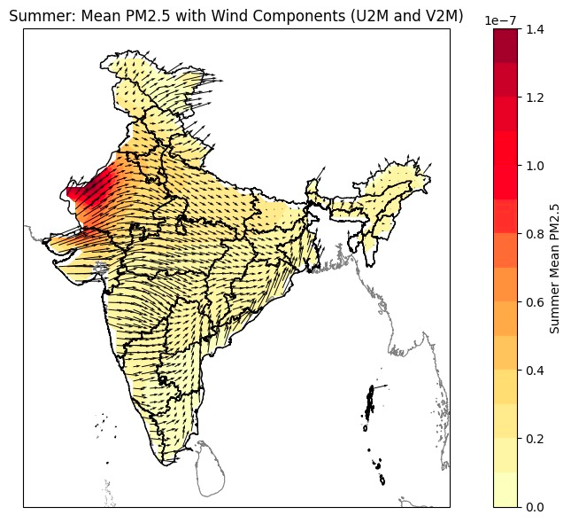
The spatial distribution of mean summer PM₂.₅ concentrations across India, overlaid with wind vector fields, reveals a distinct pattern compared to winter.
This pronounced hotspot in the arid northwest can largely be attributed to natural dust emissions driven from Thar Deserts.
The wind vectors indicate strong, consistent westerly and northwesterly winds, which are characteristic of pre-monsoon circulation patterns. These winds facilitate the long-range transport of mineral dust from desert regions such as the Thar Desert and parts of Pakistan into the Indo-Gangetic Plain and further eastward.

Slide 38
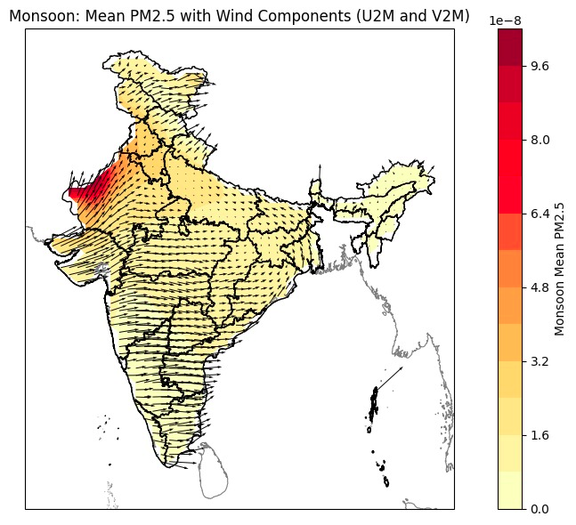
During the monsoon season, the spatial distribution of mean PM₂.₅ concentrations indicates relatively elevated levels over northwestern India, particularly in western Rajasthan, with concentrations gradually decreasing toward central and southern regions.
The overlaid wind vectors show a dominant northwesterly flow, moving toward the southeast and east, which likely facilitates the transport of dust-laden air from the Thar Desert toward central and eastern India.

Slide 39
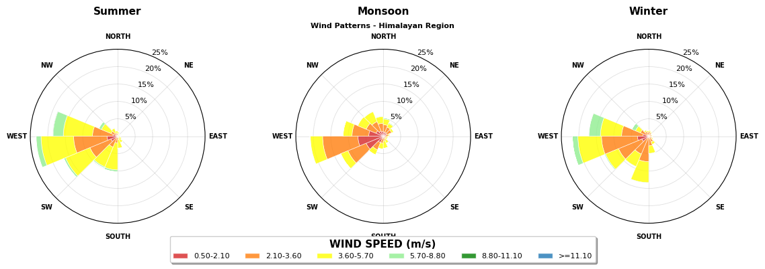
ss

Slide 40
KEY OBSERVATIONS
1. Dominant Wind Direction
Across all three seasons, dominant winds blow from the West and South-West directions.
This implies that air masses are entering the Northwest Himalayan region from the side of Thar Desert and parts of western Himachal Pradesh.
ss
ss
ss
2. Wind Speed Patterns
Most wind speeds lie in the 2.1–5.7 m/s range, especially during all seasons, shown as orange to yellow shades in the wind rose plots.
In Summer and Winter, there are occasional stronger winds (green shades), especially from the Western directions, helping disperse pollutants.

Slide 41

🧪 Code Snippet: Wind Rose Plot Across the Northwestern Himalayas (2010–2024)

Slide 42
BIVARIATE POLAR PLOTS
ss
ss
What are Bivariate Polar Plots?
Why to use ?
They help in identifying the source of air pollution by showing how pollutant levels vary with both wind speed and direction.
Bivariate polar plots are a graphical tool used to visualize the relationship between two variables.
Example : Pollutant concentrations, and wind speed and direction, within a polar coordinate system.

Slide 43
KEY FEATURES AND USES
ss
ss
Understanding Source Proximity:
The radial distance from the center of the plot can provide an indication of how close the source is to the monitoring location
Visualizing Concentration Patterns:
The plots use color scales to represent pollutant concentrations, making it easy to see where concentrations are high or low across different wind speeds and directions.
Polar Coordinate System
The plots use polar coordinates (radius for wind speed and angle for wind direction) to represent the data.
Identifying Source Direction:
By observing the patterns of pollutant concentrations at different wind directions, it becomes easier to pinpoint the general direction of potential sources.

Slide 44
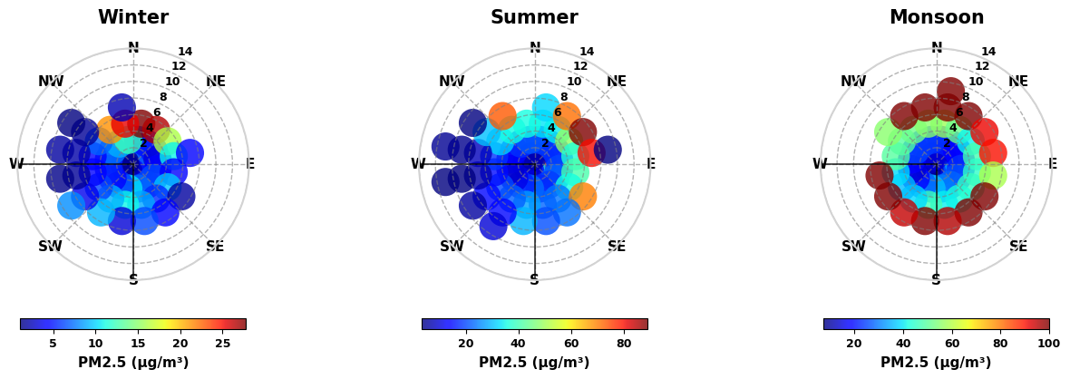
ss
The Figure shows PM2.5 pollution distribution plots for three seasons — Winter, Summer, and Monsoon — using polar bivariate plots. These visualizations combine wind direction, wind speed, and PM2.5 concentration to reveal how pollution levels vary based on wind patterns.

Slide 45
✅ EXPLANATION OF THE PLOT :
ss
ss
Each plot uses:
Radial distance from the center: Represents wind speed (m/s). Outer circles = higher wind speeds.
Direction (N, NE, E, etc.) : Indicates wind direction, i.e., where the wind is coming from.
Color scale : Shows the mean PM2.5 concentration (µg/m³).
Dark blue = Low PM2.5
Red = High PM2.5

Slide 46
📌 KEY OBSERVATIONS BY SEASON
During Winter and Summer, the plots show that many points are grouped in the west and southwest directions, with moderate wind speeds.
In the bivariate polar plots for Winter and Summer, most data points are clustered in the west and southwest directions, with moderate wind speeds. This shows that westerly winds are dominant during these seasons. As these winds move across arid or polluted zones, they can carry dust, smoke, and industrial pollutants, contributing to elevated PM₂.₅ levels.
The highest PM₂.₅ concentrations are found when these westerly winds reach the northern parts of the study region, coming from the thar desert and the Indo-Gangetic Plain (IGP) . These high concentrations are often associated with lower wind speeds, which reduce pollutant dispersion and cause accumulation of particles in this densely populated and pollution-prone area.

Slide 47
Unlike Winter and Summer, the Monsoon plot lacks a clear directional transport pattern. This indicates that PM₂.₅ is not being carried from distant regions, but rather tends to accumulate locally.
The low wind speeds reduce the atmosphere’s ability to disperse pollutants, while high humidity and frequent rainfall lead to complex effects:
On one hand, rain cannot help remove particles from the air.
On the other hand, stagnant and humid conditions—especially between rainfall events—can trap pollutants near the surface, especially in urban and valley regions.
Along with this , there is a transport of dust from thar desert that increases the accumulation.

Slide 48
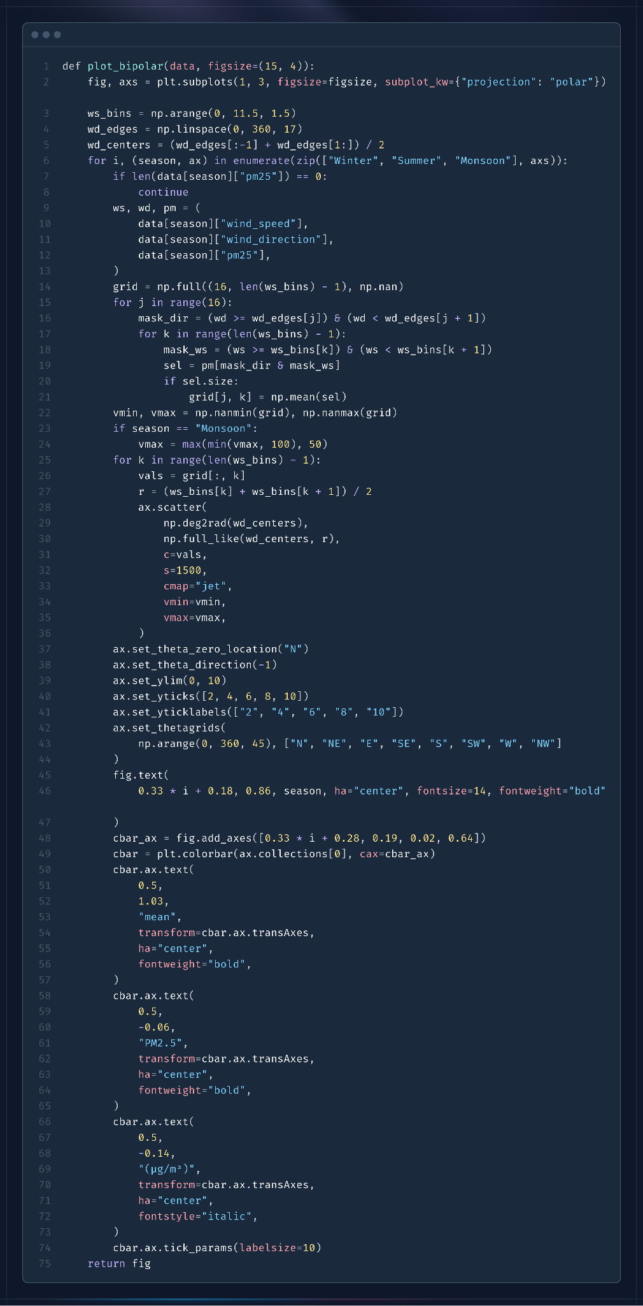
🧪 Code Snippet: Bivariate Polar Plots Across the Northwestern Himalayas (2010–2024)

